Slide 1
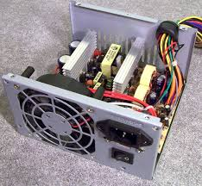
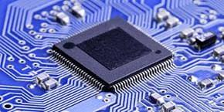
Hardware Modules
Power supply unit
Microcontroller unit

Slide 2
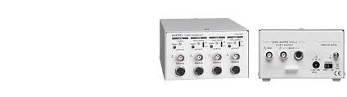
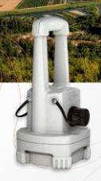
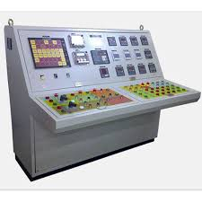
Sensor unit
Wirelesss transmission unit
Control console
Motor unit

Slide 3
Software Modules
Obstacle Identification
Obstacle Mapping
Navigation
Obstacle Avoiding
Direction Control
Temperature Measurement ,Transmission and storage
Illumination Measurement ,Transmission and storage
Humidity Measurement ,Transmission and storage
Temperature Control and Self Protection
Visual Surveillance, Transmission and storage

Slide 4
